Slide 1
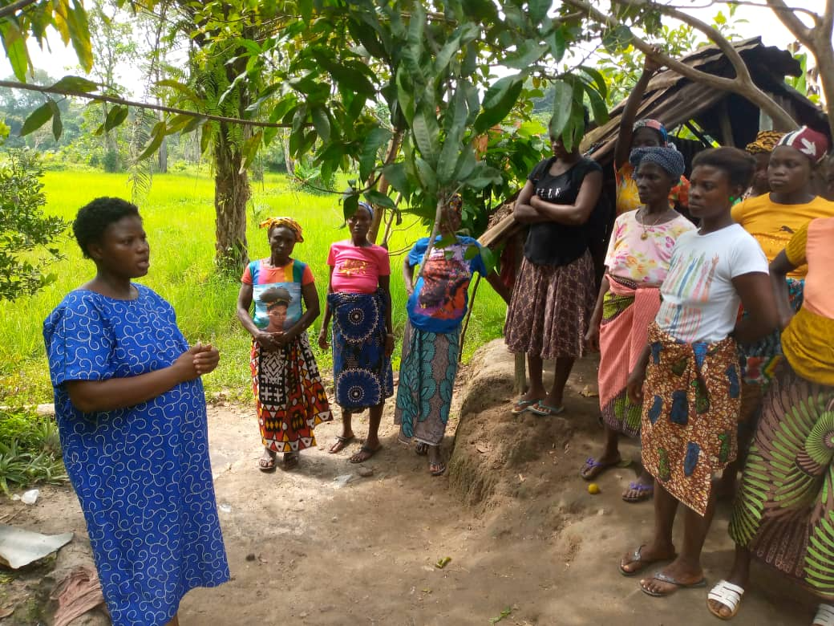

Policy Advocacy in Practice
Reclaiming Women’s Land Rights in Sierra Leone
TrustAfrica – Reclaim Sustainability Programme
Rachel Gyabaah

Slide 2
Presentation Overview
Context: Land governance and women’s rights
Case story of a widow’s land dispute
Advocacy strategies used
Advocacy pathway and actors
Outcomes and lessons for policy advocacy

Slide 3
Identify issue which can be solved through advocacy and required solution
Evaluate
- outcomes at end initiative to determine if objectives of initiative were met.
Research the issue
and raise awareness
on it.
Policy Review
Agenda Setting
Policy revision
Situation analysis
Policy evaluation
Policy issue identification
Policy research
Policy monitoring
The Policy Cycle
Agenda setting
Identification of possible policy solutions
Policy enforcement
Policy implementation
Policy interpretation
Policy negotiation
Monitor
Continually gather data on actions, processes & competencies to measure progress. Make required changes to strategy
Policy Implementation
Policy Formulation
Develop strategy – what will be done, by whom, with whom, with what resources
Act
Engage targets; deliver messages; build community competencies etc.
Notes:
Advocacy cycle superimposed with policy cycle

Slide 4
Land Governance in Sierra Leone
Land is central to rural livelihoods and agricultural production
Customary systems dominate land administration in rural areas
Women contribute significantly to farming
However, inheritance practices often exclude women

Slide 5
Policy Context
Customary Land Rights Act (2022) recognizes women’s rights to land
Law prohibits discriminatory inheritance practices
Community land governance structures introduced
Implementation challenges remain in rural communities

Slide 6
Categories of Advocacy Practice
Community Empowerment
Policy Influence
Policy Change
Lobbying & dialogue
Networking
Education and Sensitization
Public Campaigning
Research
Inputting into govt consultations
Education
Rights education
Information provision
Mobilization
Skills training
Exposure to experience
Resources facilitation
Policy Implementation
Training of implementers
Monitoring & research
Legal action
Provision of services

Slide 7
The Case: Widow’s Land Dispute
A woman lost her husband and faced eviction from farmland
Husband’s family claimed ownership under customary norms
Widow risked losing her livelihood and economic security
Case reflects broader structural gender inequalities

Slide 8
Civil Society Intervention
Civil society partners supported community engagement
WIMSAL mobilized local women and community members
Legal literacy campaigns explained new land law
Community land committees established

Slide 9
Advocacy Strategy 1: Legal Awareness
Community dialogues on women’s land rights
Explanation of provisions of the new land law
Linking customary governance with statutory protections
Shifting community perceptions on inheritance rights

Slide 10

Campaign
https://www.youtube.com/watch?v=E8ZNMnEXih8

Slide 11
Advocacy Strategy 2: Community Institutions
Formation of Community Land Committees
Committees include traditional leaders and women representatives
Institution responsible for dispute mediation
Strengthens local accountability mechanisms

Slide 12
Advocacy Strategy 3: Mediation and Social Pressure
Committee reviewed dispute with family members
Legal provisions referenced during mediation
Community pressure applied to enforce fairness
Local legitimacy strengthened the decision

Slide 13
Advocacy Pathway
Land Reform Law
Civil Society Advocacy
Community Land Committees
Rights Restored
Dispute Mediation

Slide 14
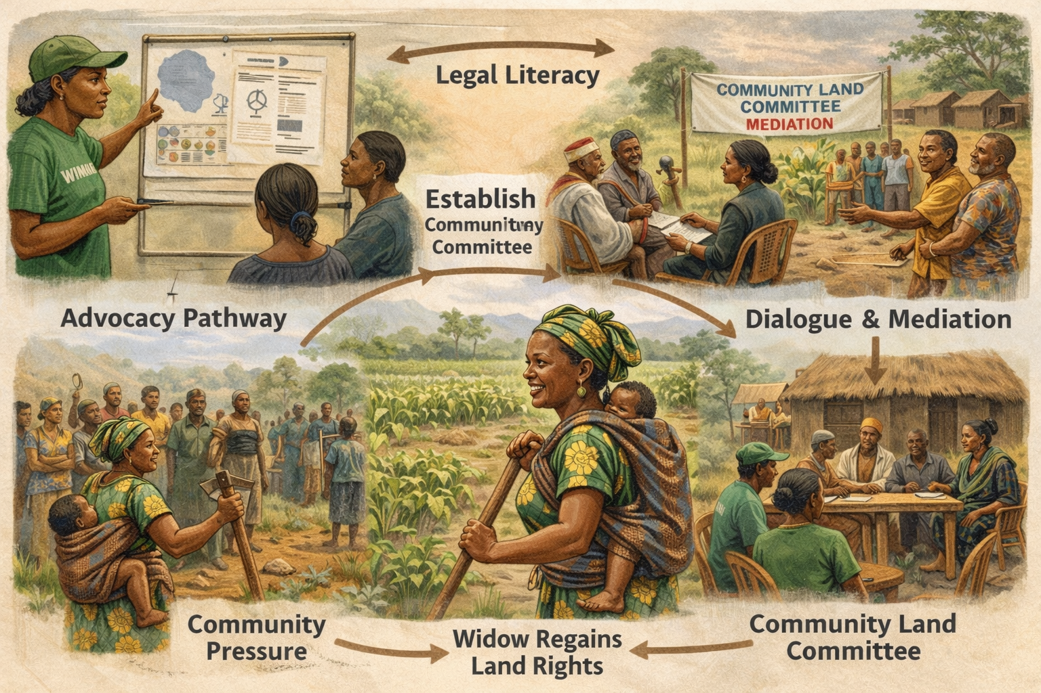

Slide 15
Power Map of Key Actors
Community Land Committee
Women Groups / WIMSAL
Traditional Leaders
Civil Society Partners
Local Government

Slide 16
Impact: Before vs After
BEFORE
Widow lost farmland
Customary norms denied inheritance
Risk of poverty and food insecurity
AFTER
Land rights restored
Community precedent established
Greater awareness of women’s land rights

Slide 17
Policy Advocacy Outcomes
Widow regained access to her farmland
Community acknowledged legal protections for women
Land committee demonstrated effectiveness
Case created precedent for future disputes

Slide 18
Lessons for Policy Advocacy
Legal reforms require strong implementation mechanisms
Community institutions are critical for enforcement
Legal literacy empowers marginalized groups
Women’s participation strengthens governance outcomes

Slide 19
Implications for Future Advocacy
Support implementation of the Customary Land Rights Act
Strengthen community land governance structures
Promote women’s leadership in land committees
Scale legal awareness campaigns in rural communities

Slide 20
Conclusion
Policy advocacy becomes meaningful when it changes real lives
The case demonstrates how law, institutions and community engagement interact
Local advocacy mechanisms can translate policy into justice

