Slide 1

POLICY ADVOCACY WITH EVIDENCE - INTRODUCTION
Master class - session 1
10.3.2026

Slide 2
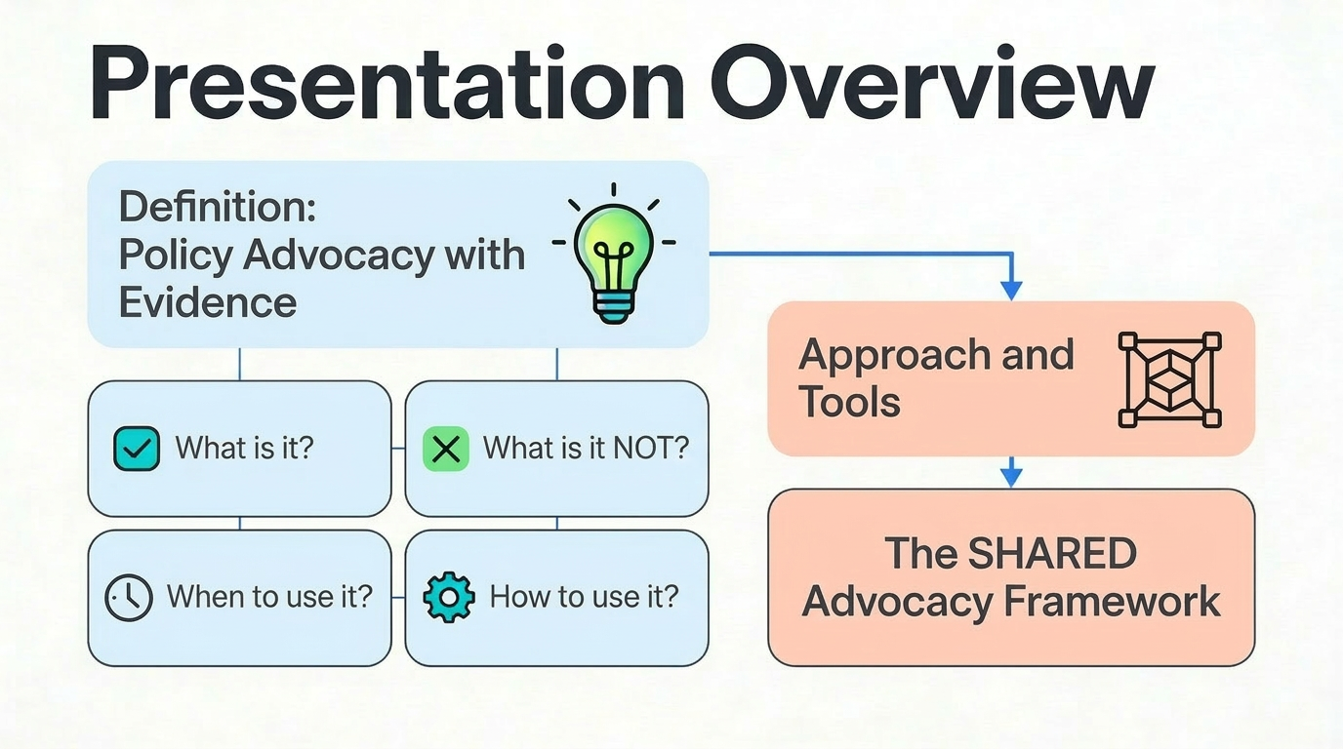

Slide 3
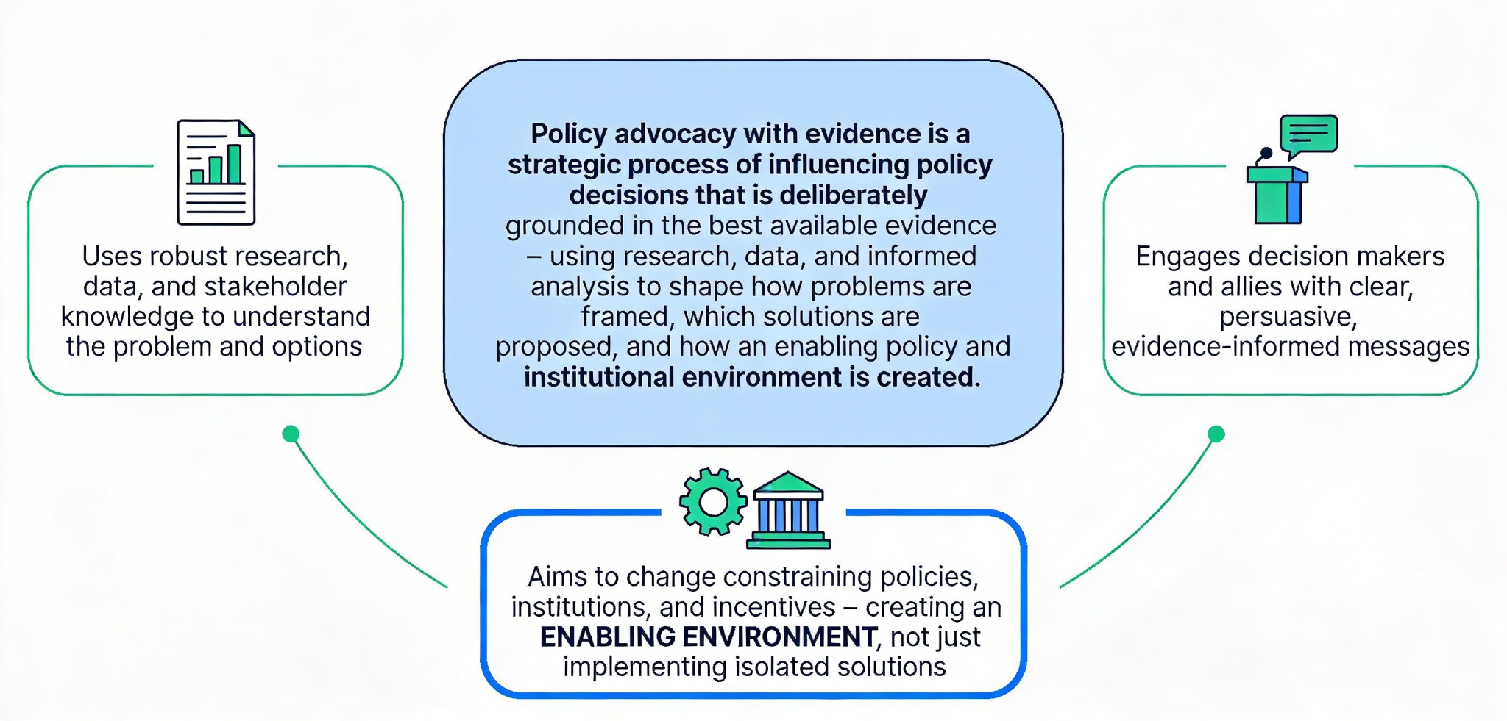
What is policy advocacy with evidence ?

Slide 4
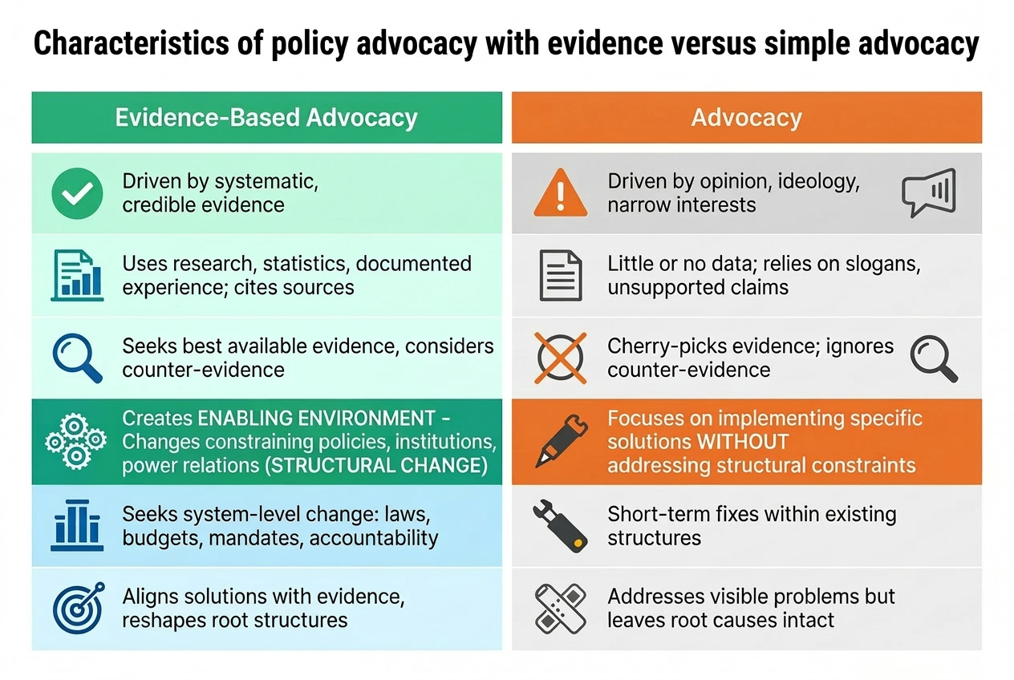
Policy advocacy with evidence V advocacy

Slide 5
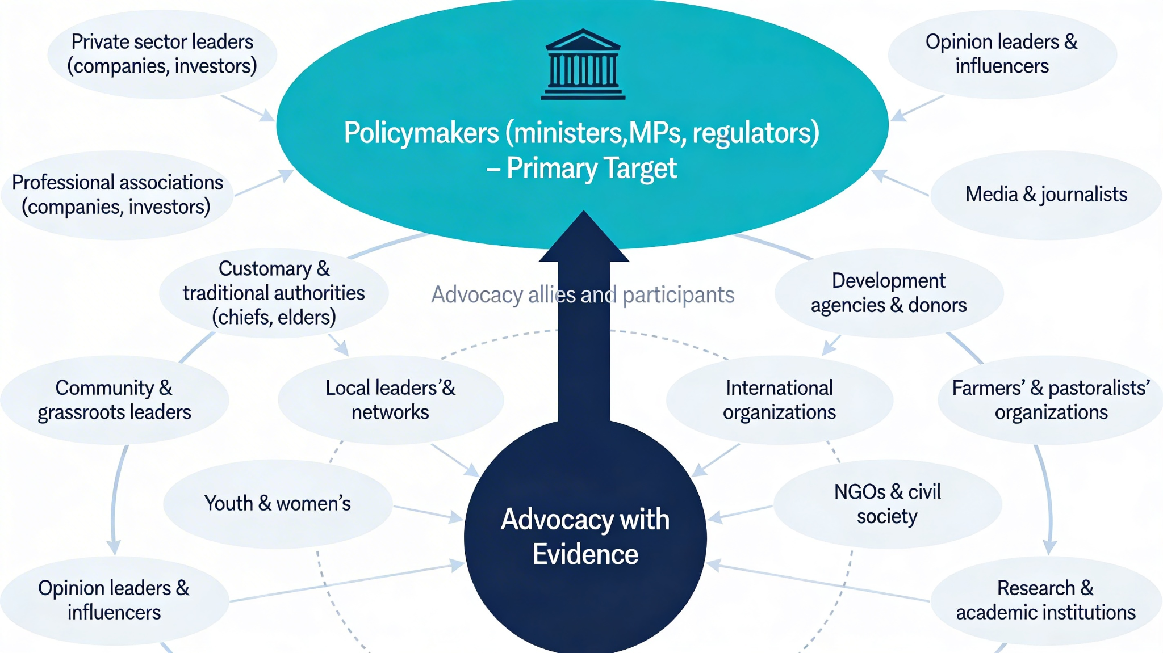
To whom policy advocacy with evidence is directed ?

Slide 6
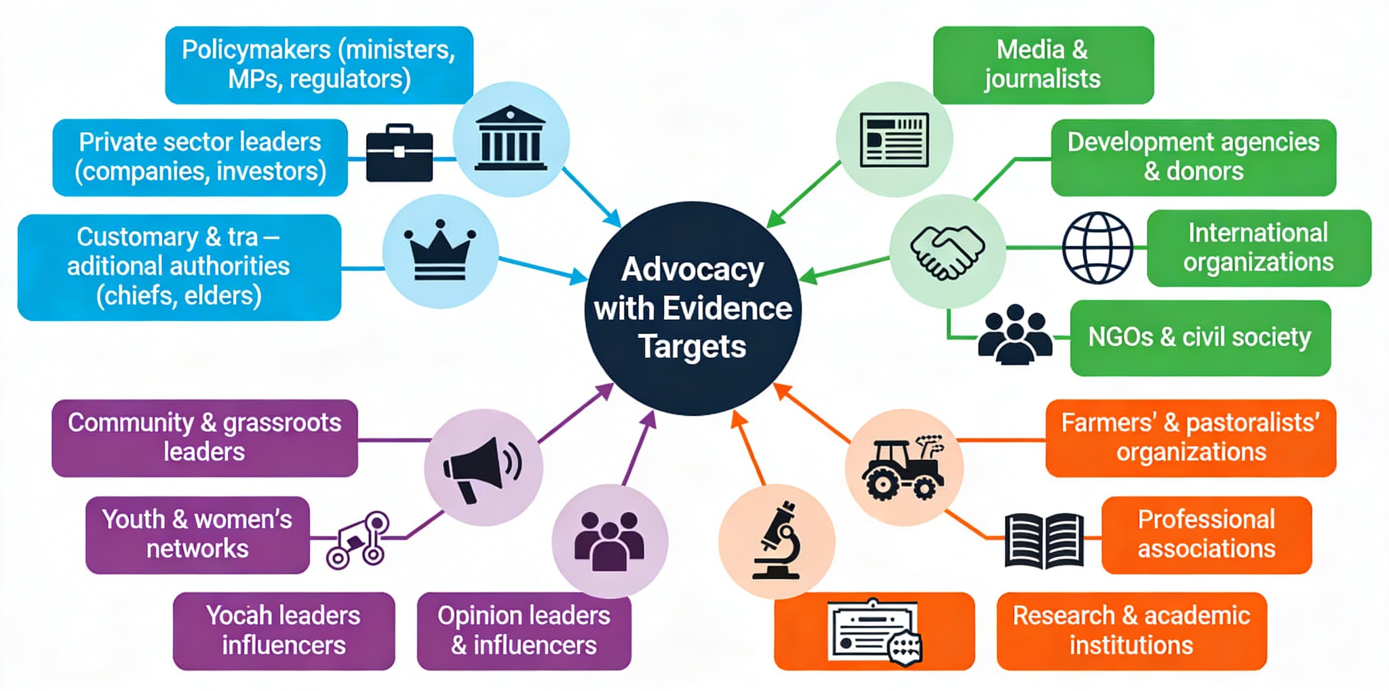
To whom policy advocacy with evidence is directed ?

Slide 7
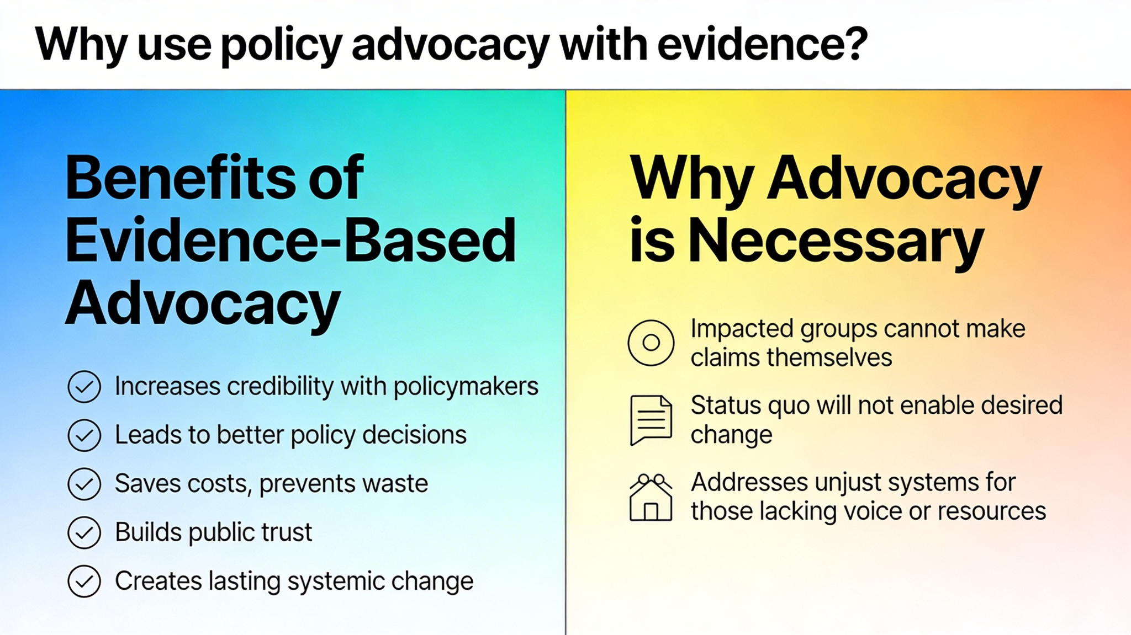
Why use advocacy with evidence ?

Slide 8
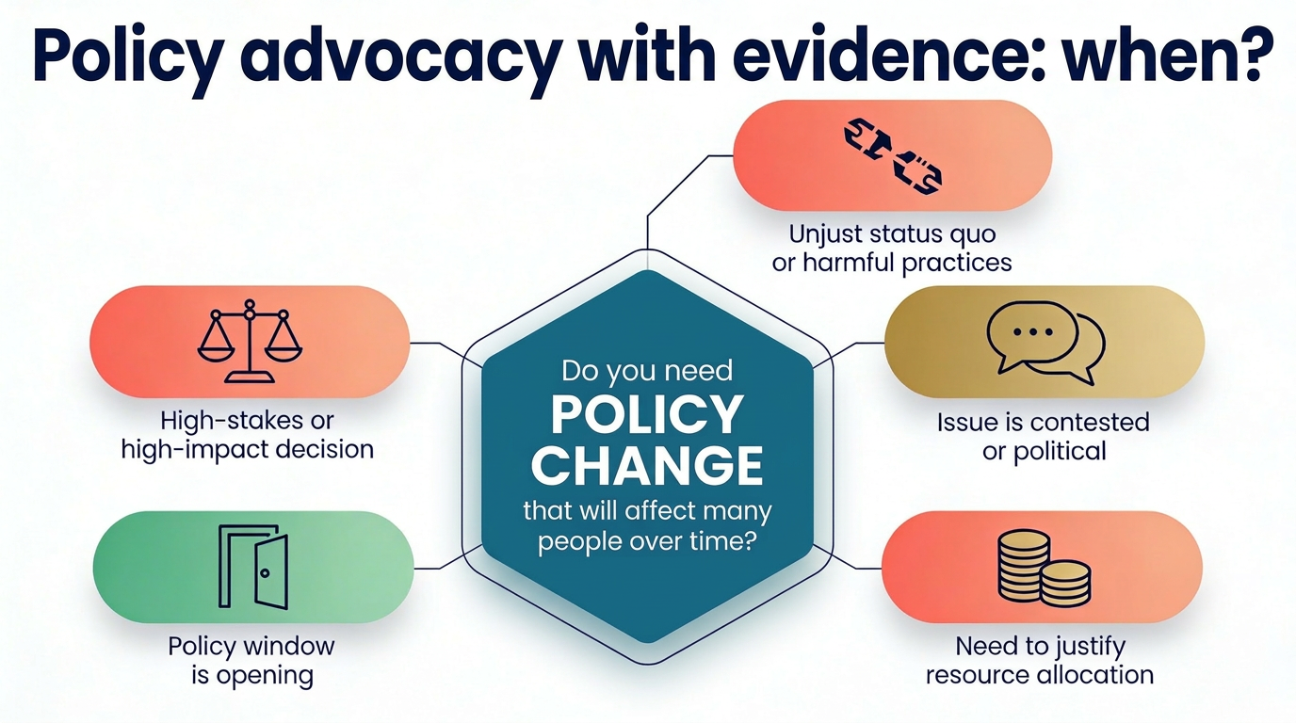

Slide 9
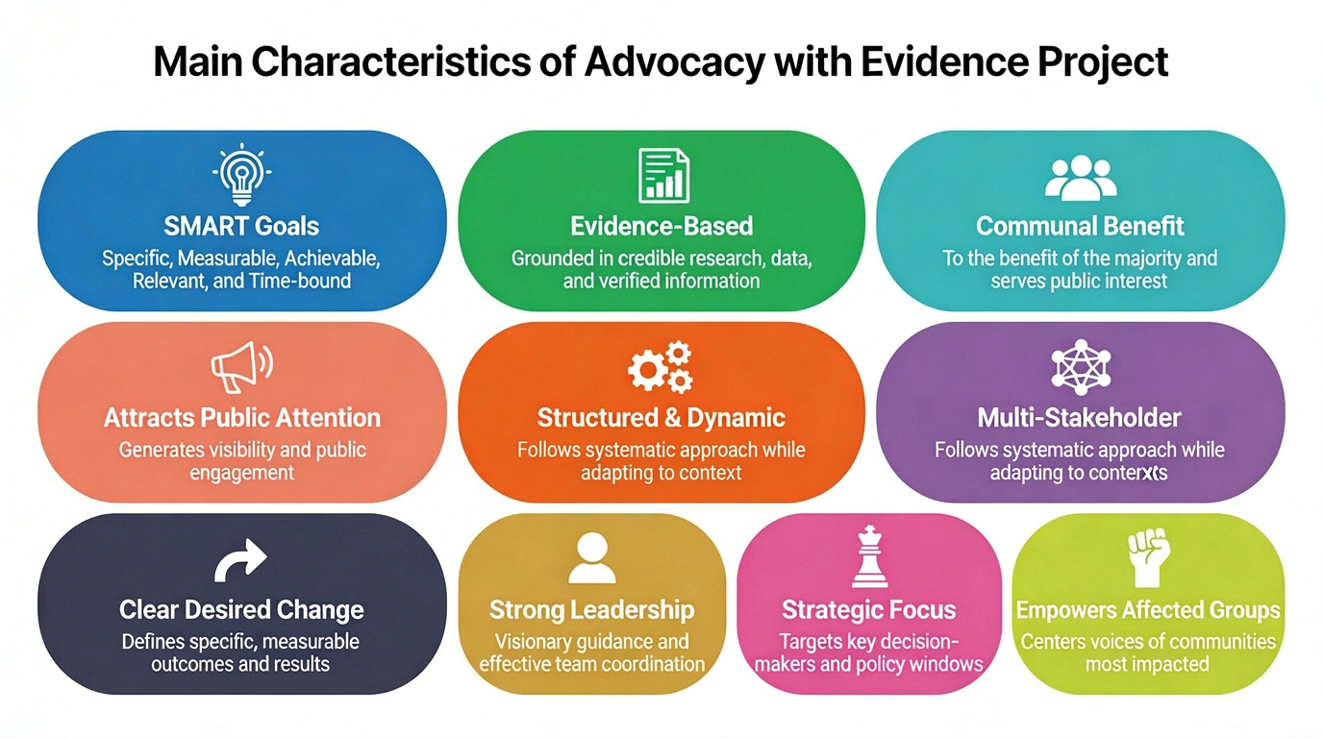
Characteristics of a policy advocacy project with evidence

Slide 10
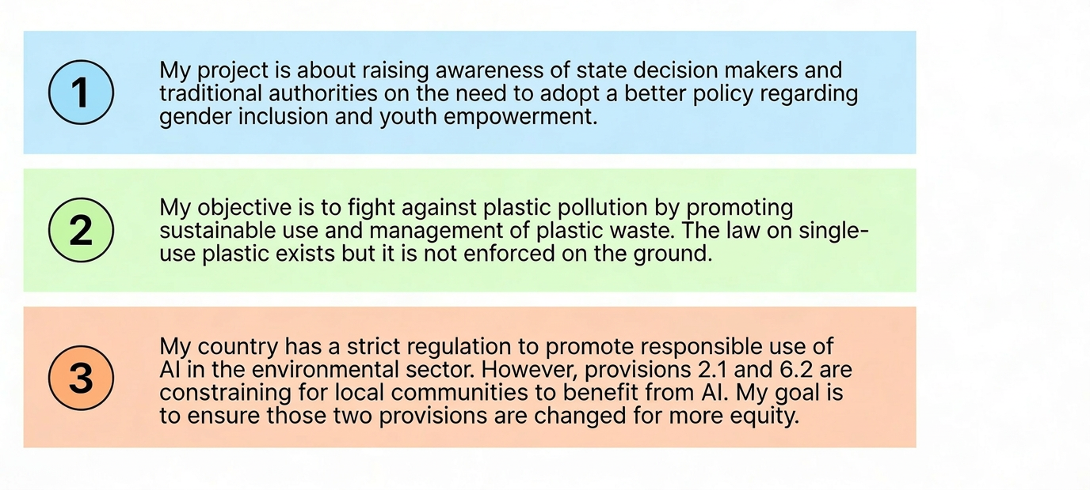
Do these initiatives require policy advocacy with evidence?

Slide 11
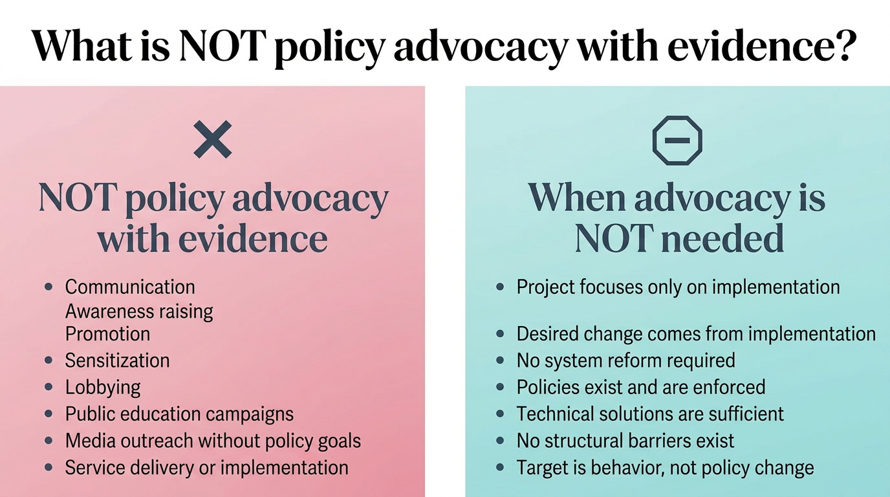

Slide 12
PART 2
ADVOCACY FRAMEWORK

Slide 13
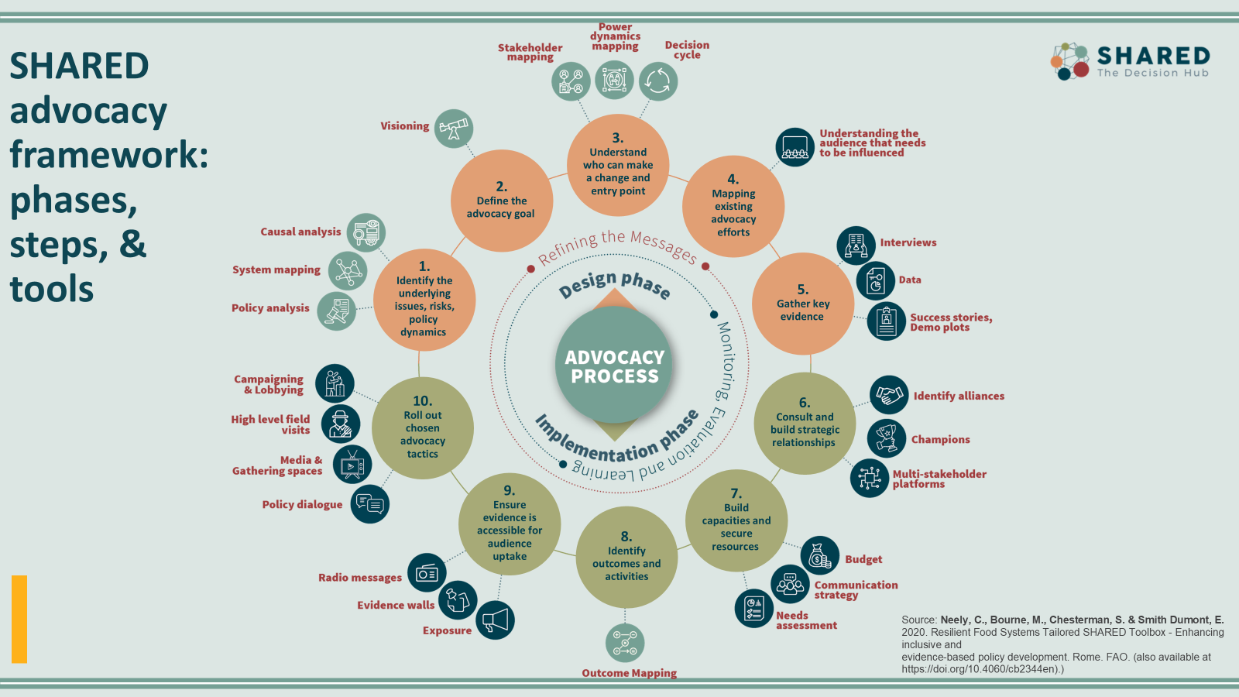
Notes:
Mieke - would you introduce this and then come back to it to explain it later

Slide 14
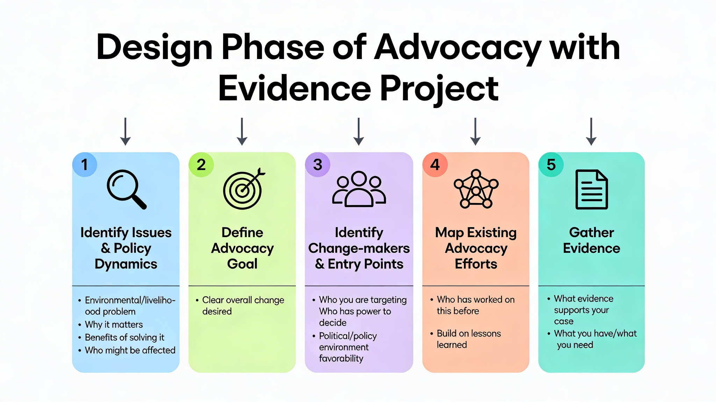

Slide 15
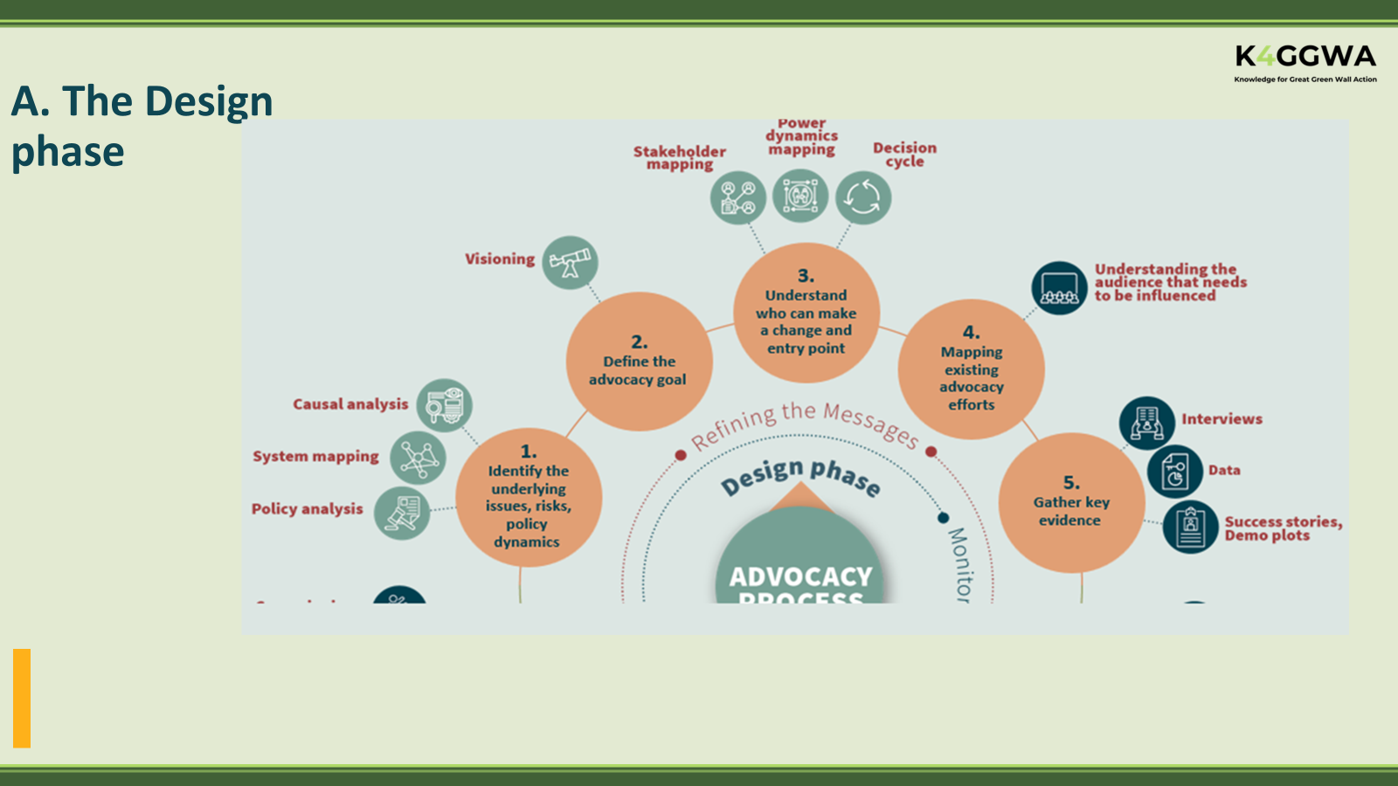
A- Design phase

Slide 16
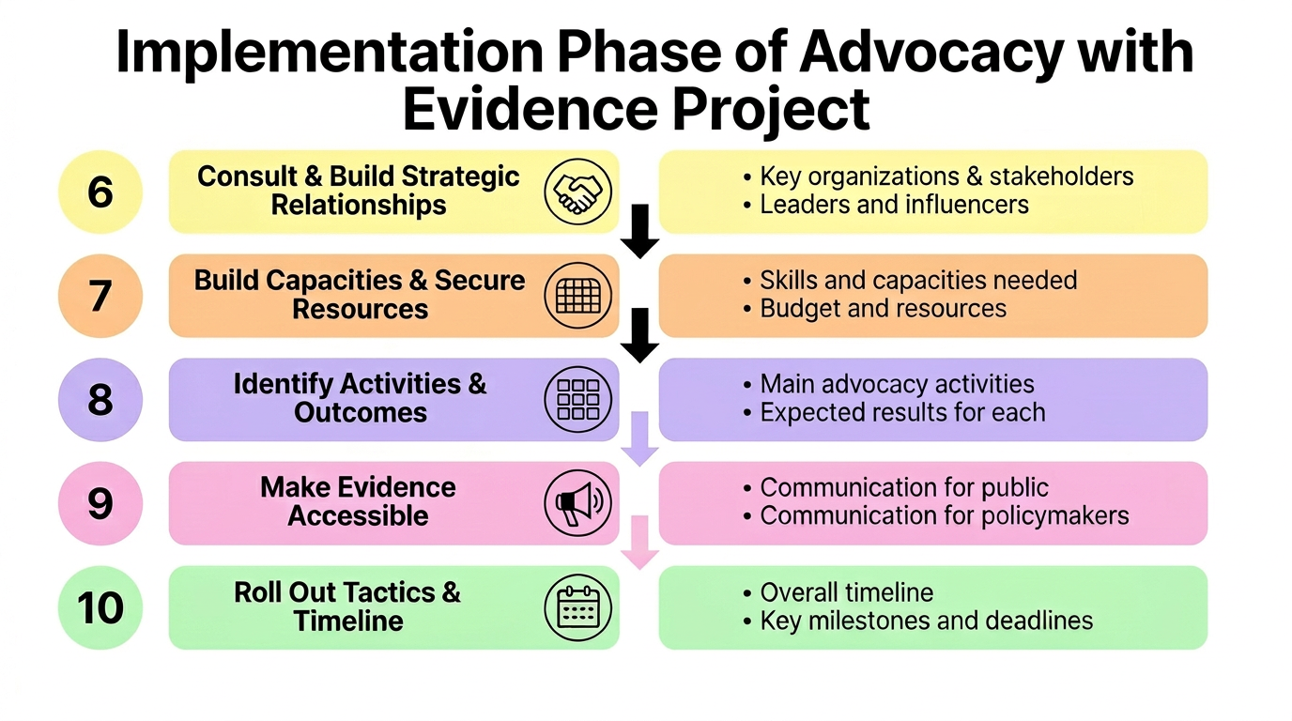

Slide 17
